Slide 1
XGBoost Algorithm for Regression

Slide 2
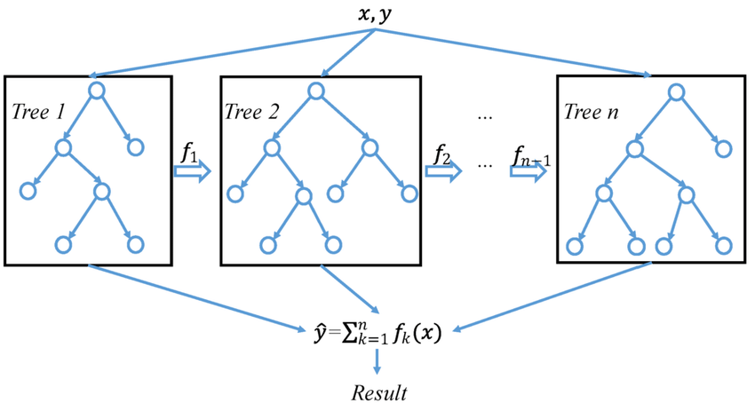
XGBoost Regressor

Slide 3
XGBoost Regressor
.
Supervised learning algorithm that can be used for regression tasks
Predict continuous numerical values
Builds an ensemble of decision trees sequentially, with each tree trained to correct the errors of the previous trees
Final Prediction: Obtained by averaging the predictions of all trees in the ensemble

